Slide 1

ANALYZING USER ENGAGEMENT
Insights from User Event Data
INTERN ASSIGNMENT
Submitted by: Aiyman Adeed Ansari
Date: 25 May, 2024

Slide 2
TOPICS
INTRODUCTION
PROCESS
INSIGHTS
CONCLUSION

Slide 3
Introduction
In this analysis, we have explored how users are interacting with the application on different levels by identifying various trends and patterns. We have identify different features which are driving users interaction such as creating task, adding material profiles, managing inventories, accessing attendance management etc,.
This analysis has highlighted the importance of application in management through task creating, logging activities and communicating over the messages and comments.
The goal of this analysis is to extract insights which can be helpful to optimize performance and enhancing user experience.

Slide 4
Process
Data Cleaning and Preprocessing: We removed duplicate values, checked for null values, and addressed data anomalies. Additionally, we added relevant time-based columns to facilitate further analysis.
Exploratory Data Analysis: We analyzed the frequency and distribution of events to identify key user activities and engagement patterns.
Insights Extraction: We identified the top events users engage with, analyzed event occurrences by hour, day, and week to determine peak usage times, and tracked changes in user numbers throughout the year. These insights will help enhance user engagement.

Slide 5
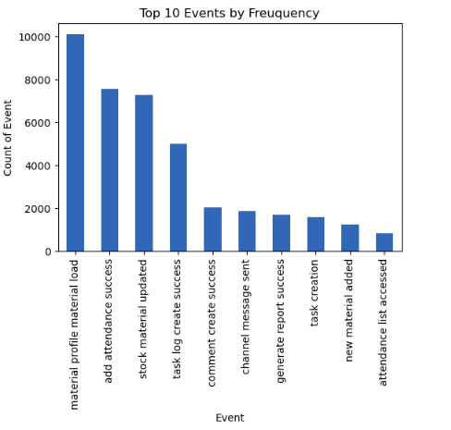
What were the most common user events?
This chart shows the top 10 Events:
Users frequently accessing the material profile, followed by marking attendance, updating inventories, creating task logs and for communications
From this data events which is highest:
material profile material load 10114
add attendance success 7569
stock material updated 7272
task log create success 5010
comment create success 2054
channel message sent 1867
generate report success 1701
task creation 1602
new material added 1243
attendance list accessed 837

Slide 6
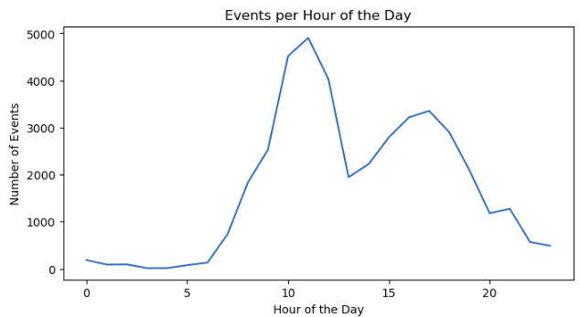
Are there specific times or days when user activity is highest?
The line chart shows numbers of events happening per hour
Peak Hours: User activity peaks around 10 AM and again around 2 PM to 4 PM.
Morning Peak: There is an increase in activity starting from 8 AM, reaching the first peak around 10 AM.
Afternoon Peak: Activity dips slightly after 12 PM but rises again to a secondary peak between 2 PM and 4 PM.
Off-Peak Hours:
Early Morning: Very low activity between midnight and 7 AM.
Evening: Activity gradually decreases after 5 PM, with very low activity post 9 PM.

Slide 7
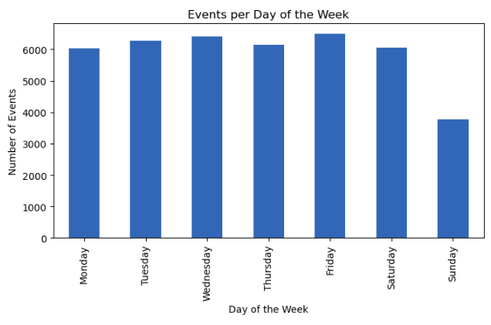
The bar chart titled "Events per Day of the Week" provides insights into user activity throughout the week:
Weekday Activity:
Highest Activity: Friday sees the highest user activity, closely followed by Tuesday, Wednesday, and Monday.
Consistent Engagement: There is a fairly consistent level of activity from Monday to Saturday, indicating that users are actively using the app throughout the week.
Weekend Activity:
Lowest Activity: Sunday experiences the lowest user activity, suggesting that users are less engaged with the app on this day.

Slide 8
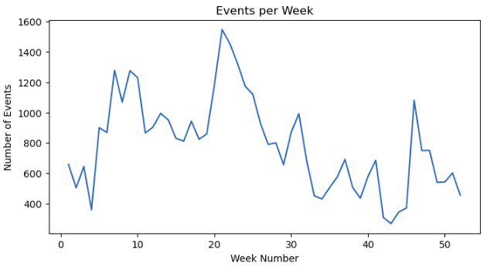
This line chart shows the number of events per week over the year.
Observations:
Weeks 1-10: Fluctuating trend with overall increase, peaking in weeks 9-10.
Weeks 11-20: Significant activity rise, with peaks in weeks 12 and 18-19.
Weeks 21-30: Gradual decline post-week 18-19 peak, maintaining moderate levels until a sharper drop after week 25.
Weeks 31-40: Continued decrease with fluctuations, reaching lower levels compared to previous weeks.
Weeks 41-50: Some increase and fluctuation, notable peak around week 45.
Weeks 51-52: Decrease towards year-end
From this data, user activity is highest:
Around weeks 9-10
Around weeks 18-19
Around week 45
These periods show significant peaks in the number of events per week, indicating higher user activity during these times.

Slide 9
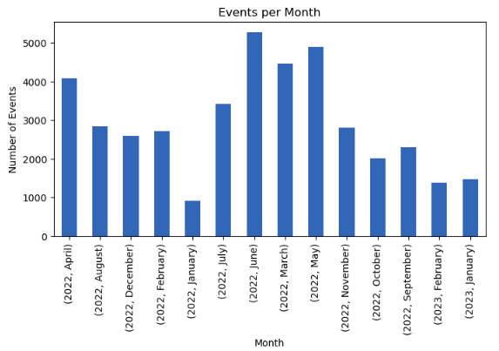
What was the trend of events throughout the month?
This chart shows the number events occurred over the year for each month
It shows that the July,2022 was the peak month followed by may,2022 and march,2022.
It also that the least event occurred in the month of January,2022 followed by february, 2023

Slide 10
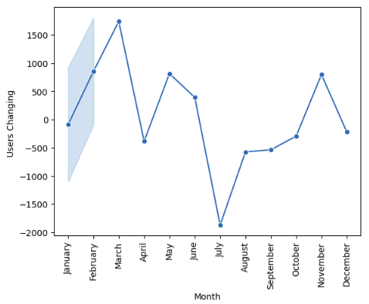
How user changing over each month?
Jan-Feb: There is significant increase in user, it peaks in February.
Mar-Apr: There is high user numbers with a slight drop in April.
May-Jun: Another peak in May, followed by a slight decrease in June.
Jul: There is significant drop, reaches the lowest point of the year.
Aug-Sep: It recovers in August and increase in users through the month.
Oct-Nov: It continues rise, peaks in November.
Dec: Decrease in user numbers towards the year's end.
Overall, user changes are highest in:
February
May
November
The lowest point in user changes is in July, indicating a significant drop in users during that month.

Slide 11
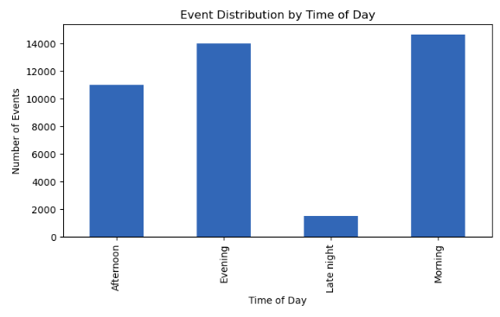
How users engaging over the day?
This bar graph shows how the users have interacted during the day:
It shows that the users have interacted mostly in morning followed by the evening and afternoon.
It has least interacted during late night.

Slide 12
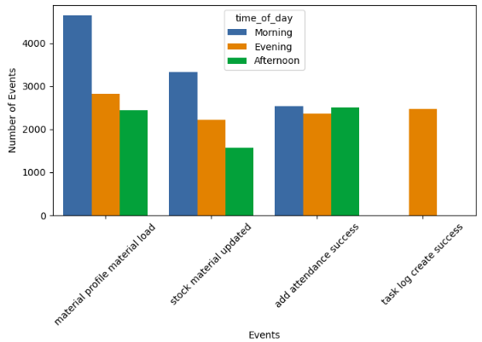
Which events were performed mostly throughout the day?
This chart show that the which event is performed most during which time of the day:
The event that was performed the most throughout the day, across all time periods, is the Material Profile Material Load event, with the highest number of occurrences in the morning followed by stock material update and the add attendance

Slide 13
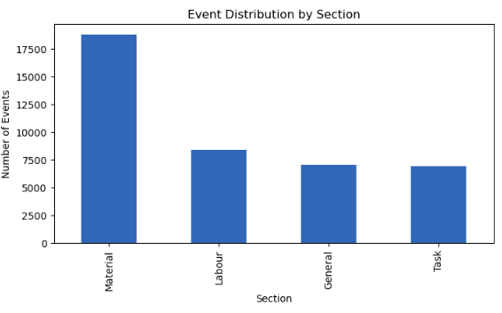
What is the number of events occurring in each section?
This bar graph shows the number of events across different sections.
It reveals that the material section is the most popular, followed by the labor section.
Also, the task section is the least popular, with the general section just above it in terms of user engagement.

Slide 14
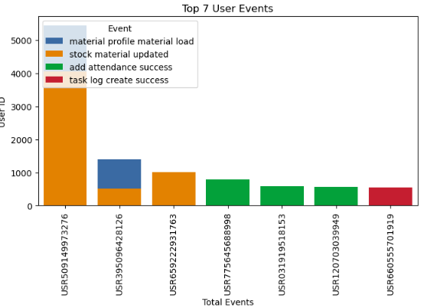
Who are the top users, and which events are they interacting with most frequently?
The bar graph displays the top 7 users and the number of events they interact with:
The top user engages in two activities: accessing material profiles and updating inventory.
Similarly, the second most active user also engages in these two events.
The remaining users interact with only one event each.
This indicates that material profiles and inventory updates are key areas of interaction for the most active users.

Slide 15
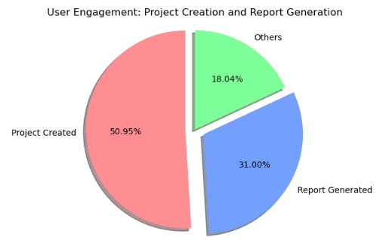
What percentage of users complete key actions?
This pie chart shows the percentage of users who have start their and also end its project by generating report.
Project Created: 50.95%
Report Generated: 31.00%
Others: 18.04%
The key actions, "Project Created" and "Report Generated," together account for 81.95% of the users.

Slide 16
Conclusion
This analysis provided valuable insights into user behavior within the application. We identified material management (profiles, loads, stock) and task management (creation, logging) as key activities. User activity peaks occur around 10am and 2-4pm on weekdays, with Friday's showing the highest engagement. User numbers see significant increases in February, May, and November, while July experiences a drop. Material management is the most popular section, followed by Labor and Task sections.

Slide 17


